Slide 1




Continuous everything with Visual Studio App Center
Riccardo Cappello
Operative Manager @ ALTEN Italia
Microsoft Azure MVP | Intel Software Innovator
Marco Leoncini
TechLead/PM @ ALTEN Italia
Former MVP | ASPItalia member
#vssatpn
Notes:
m

Slide 2










A decentralized world
Notes:
m.
Since the beginning of the 21st century, the way we do system and application design has changed drastically.
Everything is getting an API. As a developer, you can make an API call to complete a financial transaction, get your heart rate, back your car out of the garage, or even to translate into another language, or to read an X ray. As developers, we love these new APIs because they’re almost like superpowers. And we know you love this, too.
This means users expect seamless interactions across multiple devices, simple to extend and managed with a beautiful user interfaces.

Slide 3
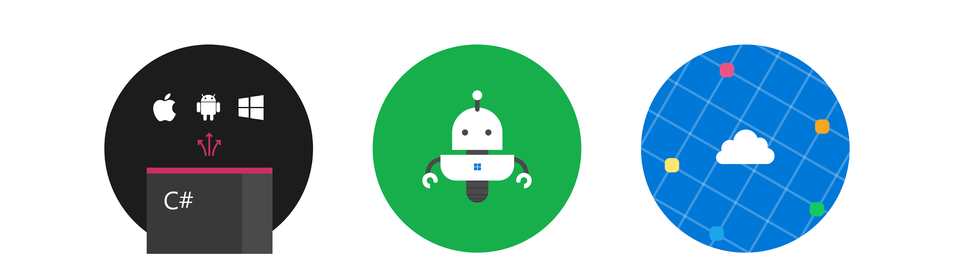
Finding a focus
Shared code
Write less code with better tools
Automation
Automate the development lifecycle
Apps in the cloud
Power apps with cloud services to innovate
Notes:
m.
There were a couple ideals we knew we wanted to focus on – sharing code, automation and bringing all of our apps into the cloud.
Attacking one of those problems wouldn’t get us where we needed to be so it was essential we launched a horizontal attack across all issues to make sure we encompassed to the real scope of the problem.
We needed to create the opportunity for more teams to share code so we could stop being repetitive.
This meant working towards shared libraries, such as 1 Microsoft SDK to power crash handling, analytics gathering and beta testing for all of our mobile applications.
Automation to us meant not only removing daily work, but removing the setup work required to get going.
Apps in the cloud would allow us to share data, resources and applications easier with eachother in the organization.
Breaking down silos that in the past have forced us to crawl rather than sprint.

Slide 4

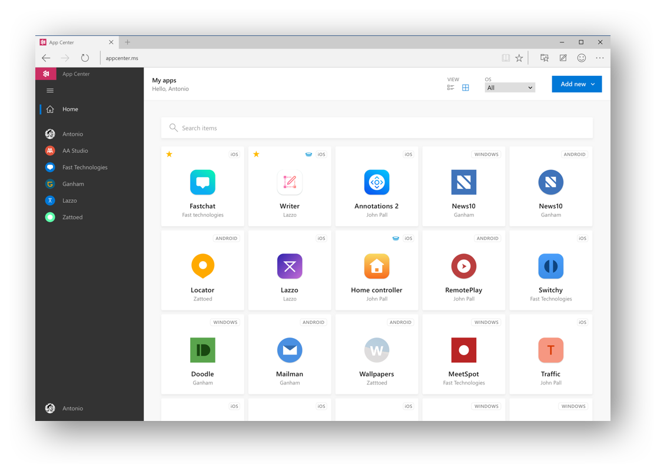
Visual Studio
App Center
appcenter.ms
Notes:
R

Slide 5
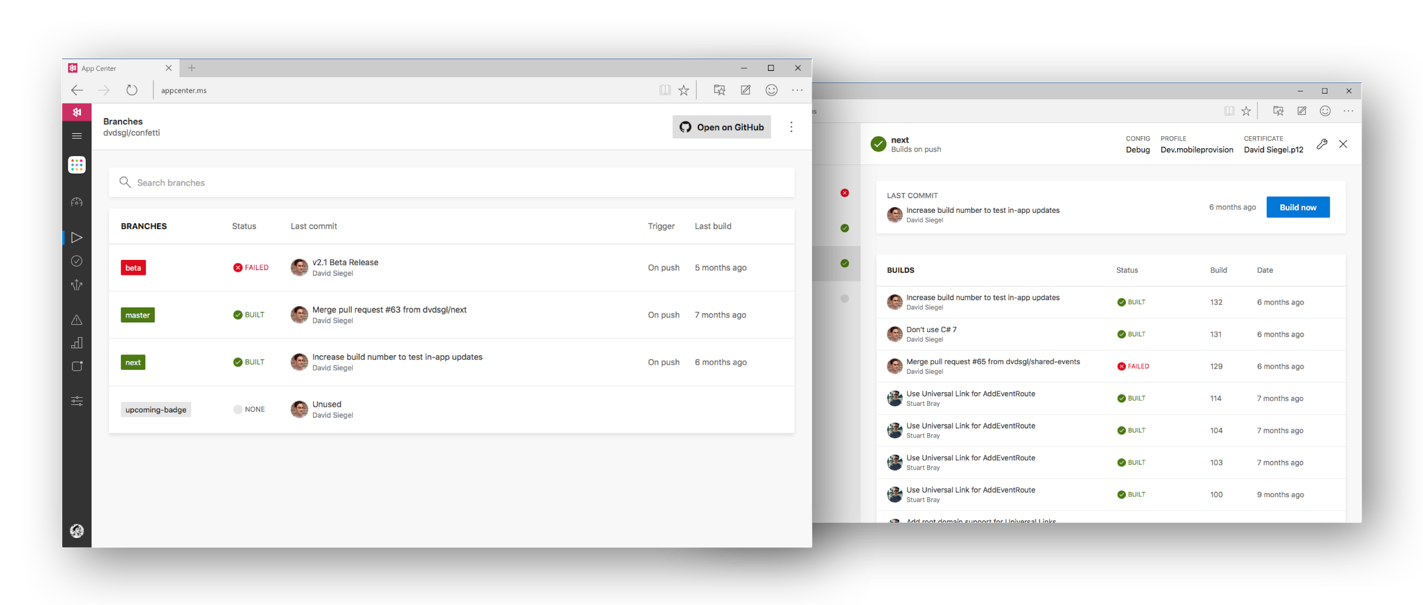






Visual Studio App Center
Notes:
R

Slide 6
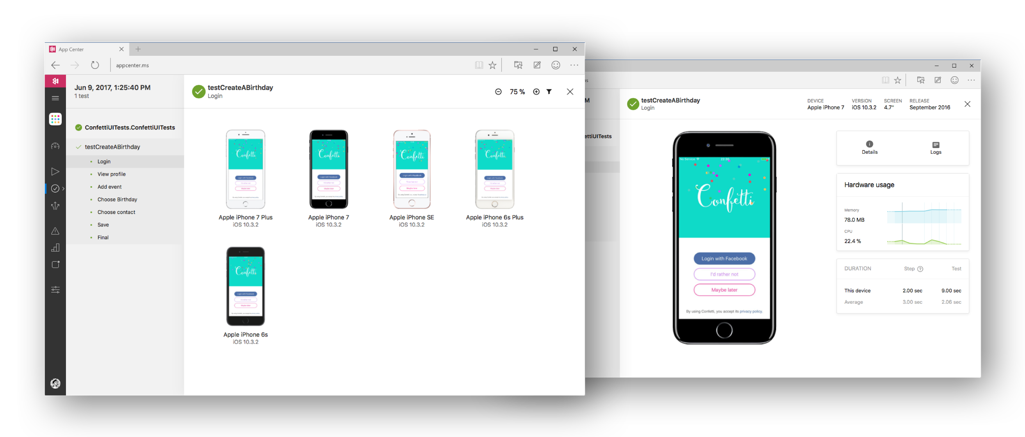


Visual Studio App Center
Notes:
R

Slide 7
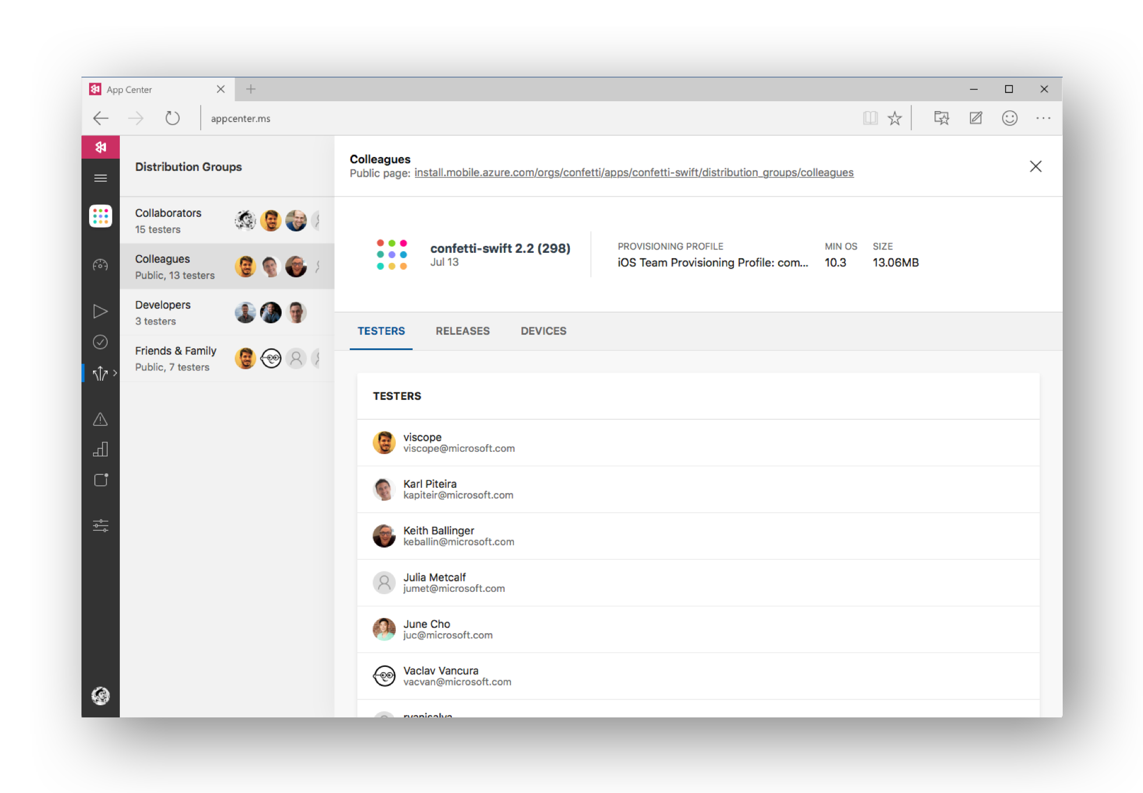

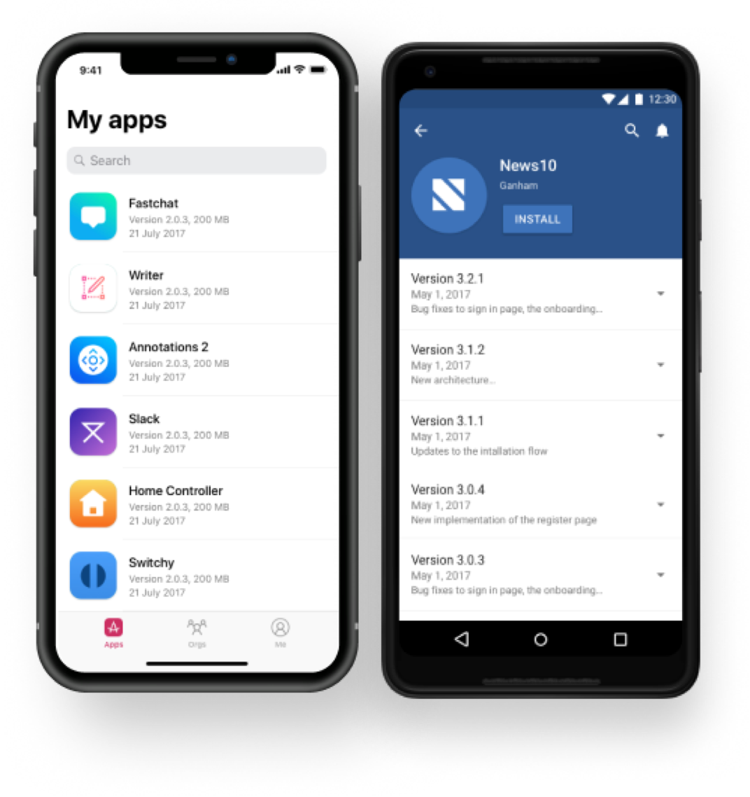

Visual Studio App Center
HockeyApp
iOS, Android, UWP
Notes:
R

Slide 8
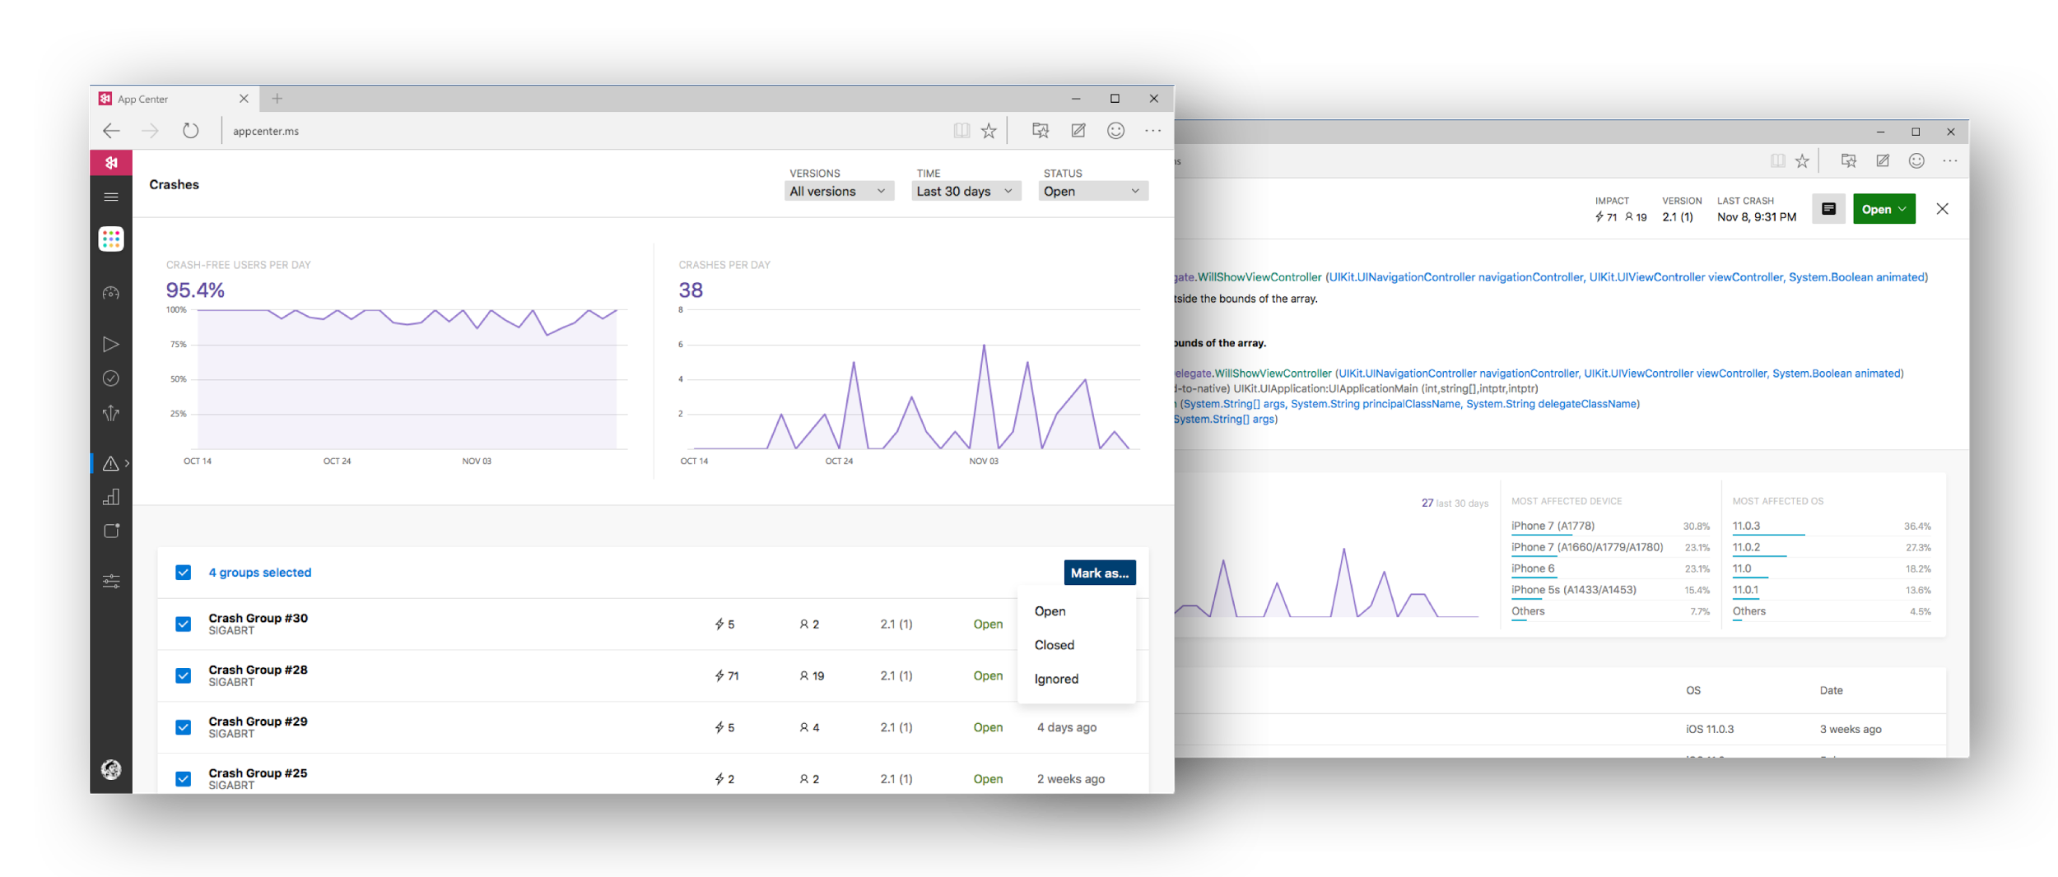

Visual Studio App Center
Notes:
M

Slide 9
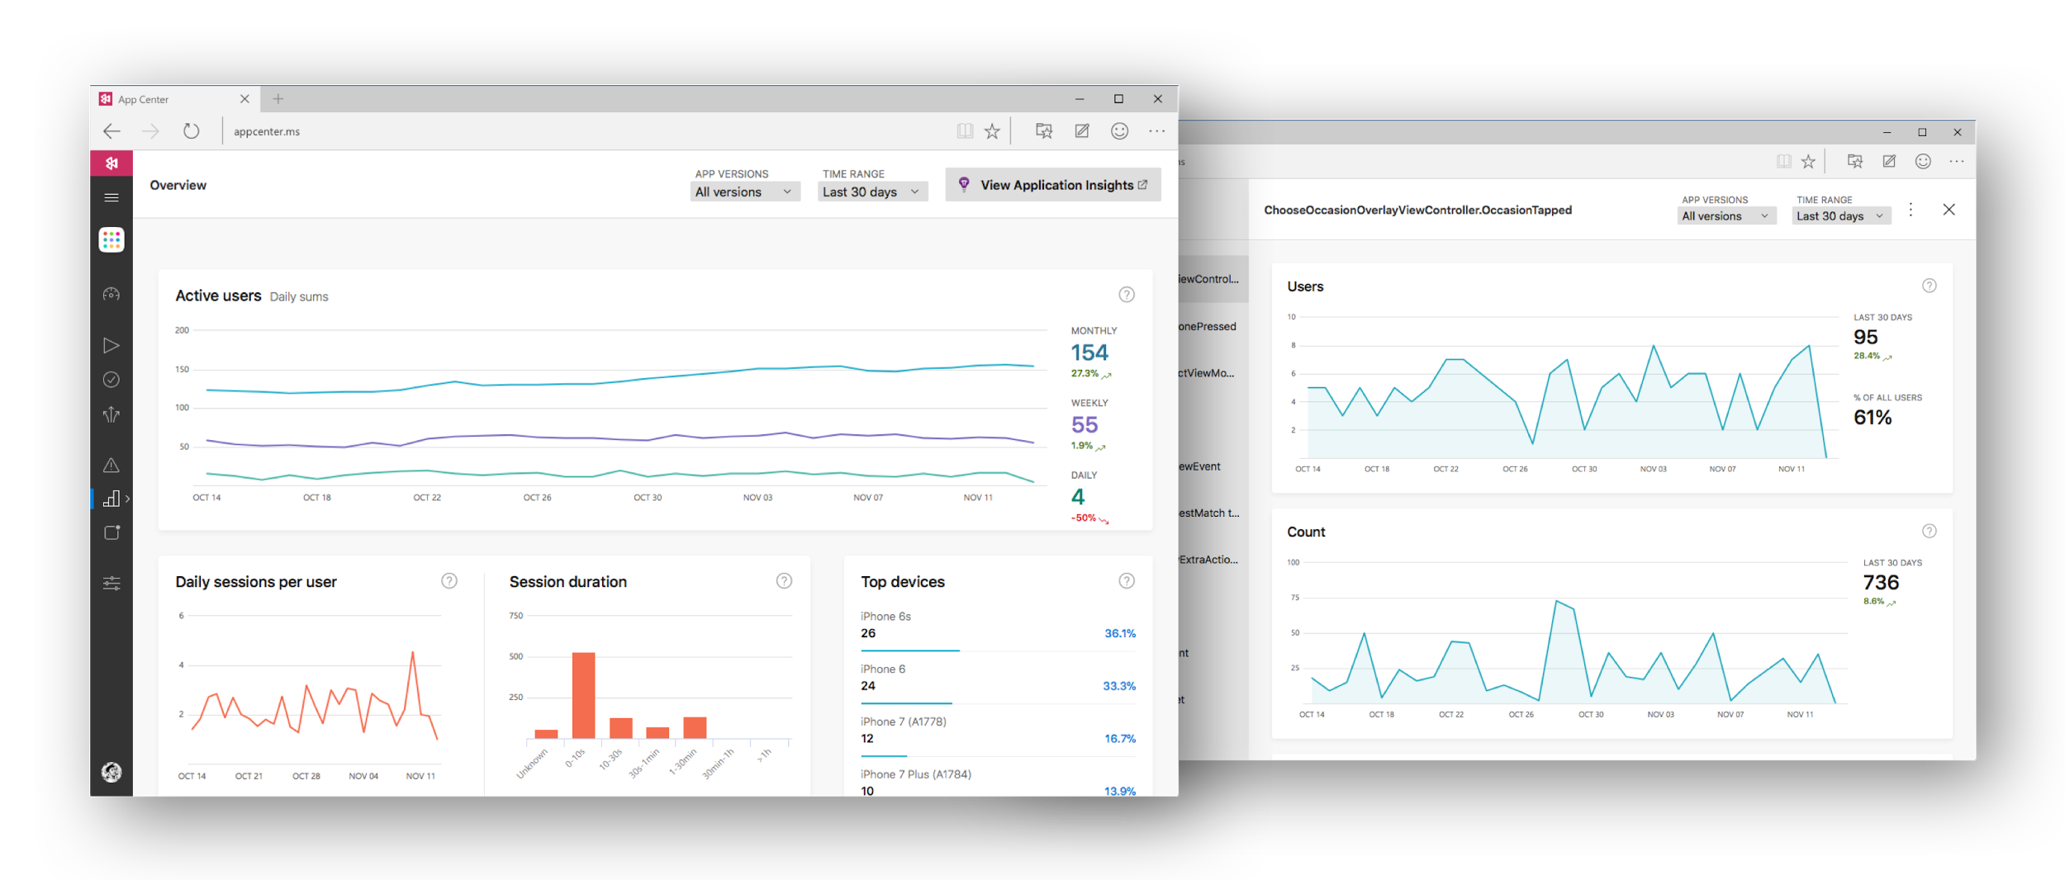
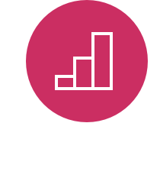
Visual Studio App Center
Notes:
M

Slide 10
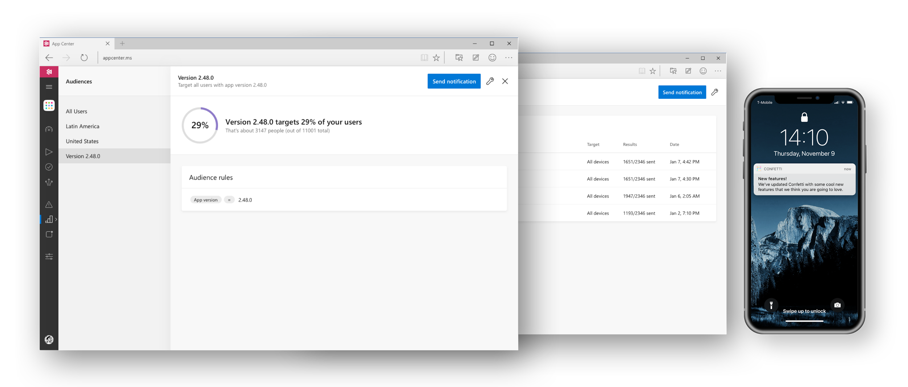

Visual Studio App Center
Notes:
R

Slide 11
Demo
Visual Studio App Center
Notes:
Portale, utenti e organizzazioni, settings organizzazione, creazione nuova app

Slide 12
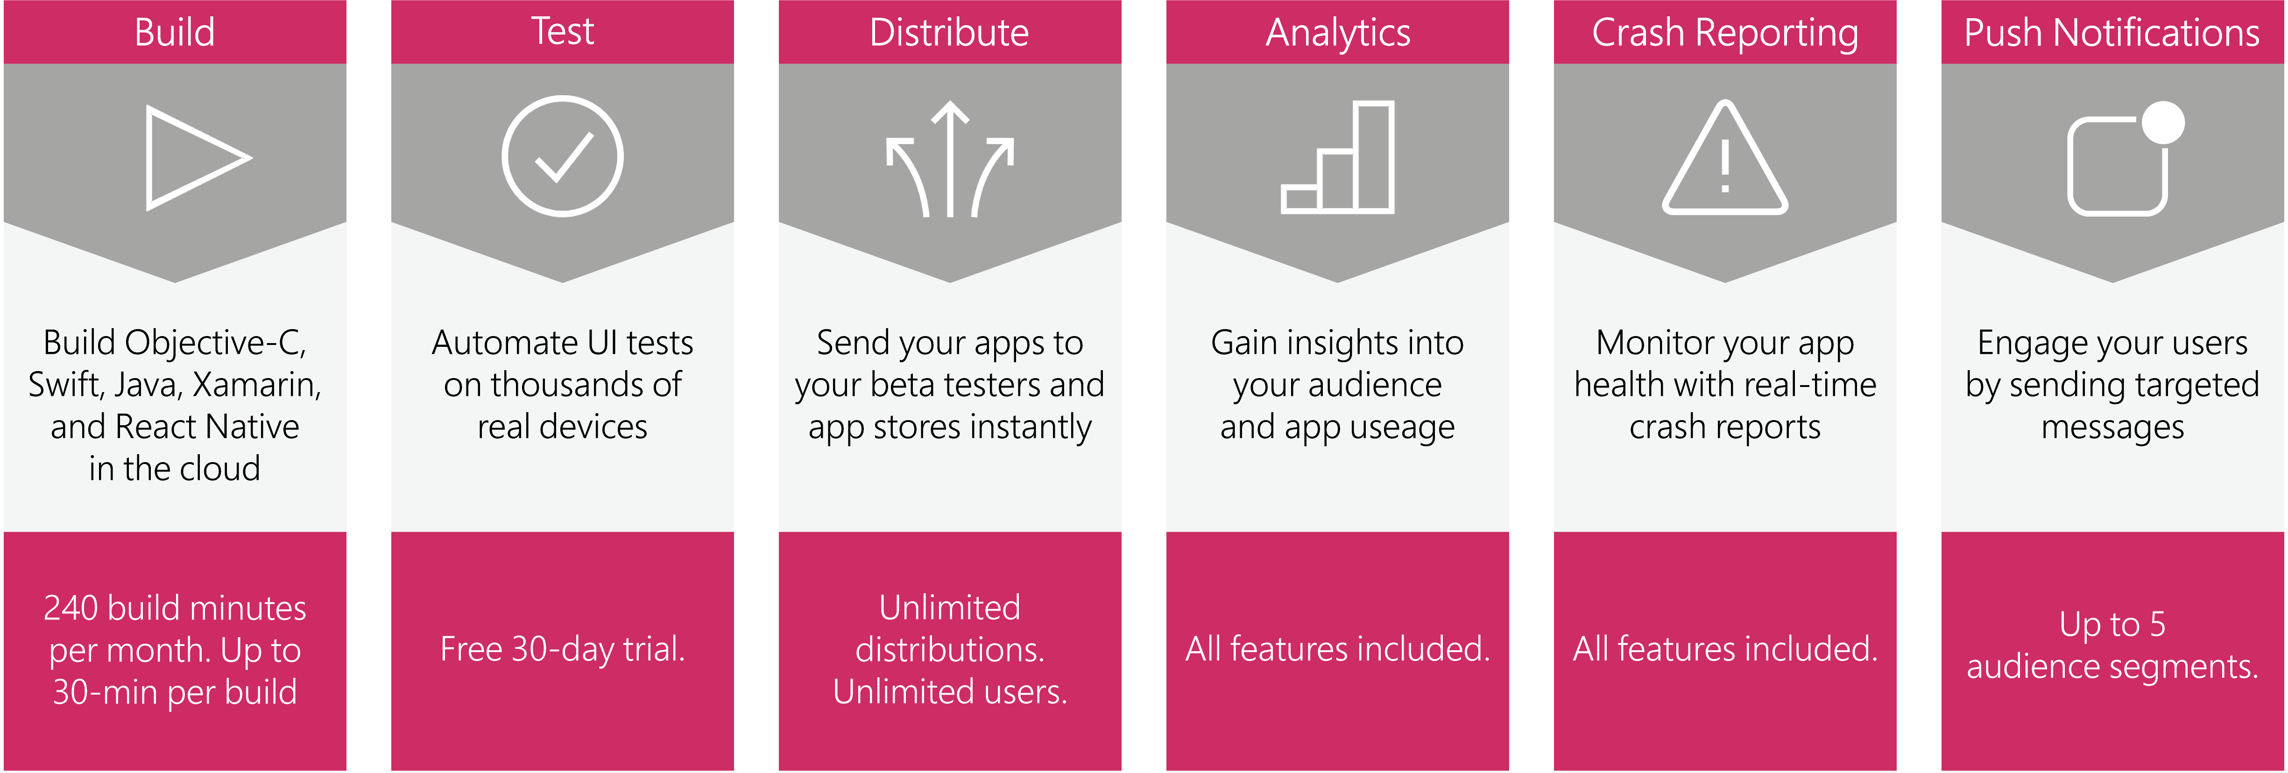
Run unlimited, faster builds
Test your app in the cloud
Target additional audience segments
Ship your app faster with multiple builds running in parallel.
Each paid build comes with unlimited build time, ensuring all builds run and complete.
Run UI tests on thousands of real devices and hundreds of configurations.
Each device concurrency comes with 30 device hours per month, with an upgrade option for unlimited hours.
Engage your audience with targeted messaging at the right time.
Pay per number of monthly active devices for targeting more than 5 audience segments.
+$40/month
per build concurrency
+$99/month
per test device concurrency
+$10/month
per 100k active devices
Notes:
Highlight zero cost of entry, pay-as-you-go, pay-for-only-what you use

Slide 13
appcenter.ms
Notes:
Give it a try at appcenter.ms

Slide 14
Thank you!
Riccardo Cappello
Operative Manager @ ALTEN Italia
Microsoft Azure MVP | Intel Software Innovator
rcappello@outlook.com
Marco Leoncini
TechLead/PM @ ALTEN Italia
Former MVP | ASPItalia member
Nostromo_@hotmail.it

